Slide 1
SES 101: The What & How of the Senior Executive Service
Patrina M. Clark
President & Founder, Pivotal Practices Consulting LLC
April 13, 2017

Slide 2
My Journey – High-Level Overview
Federal Election Commission
2006 – 2008
U.S. Government Accountability Office
2008 – 2011
Internal Revenue Service
1986 – 2004
Veterans Affairs
1989 – 1990
Naval District Washington, Navy
2004 – 2006

Slide 3
Webinar Overview
The What
About the SES
Benefits and Awards
By the Numbers
The How
Filling an SES Position
Applying for an SES Position
Resources
Serving In An SES Position
OPM Onboarding Roadmap
Your First 90 Days
Time for Questions
Closing Thought

Slide 4
The What
What Is the SES?| Pay | Benefits | By the Numbers

Slide 5
What Is the SES?
“It is the purpose of this subchapter to establish a Senior Executive Service to ensure that the executive management of the Government of the United States is responsive to the needs, policies, and goals of the Nation and otherwise is of the highest quality.”
- Civil Service Reform Act (CSRA) of 1978
Notes:
The Senior Executive Service was created in 1979 when the Civil Service Reform Act of 1978 went into effect under President Jimmy Carter. the SES was designed to be a corps of executives selected for their leadership qualifications, serving in key positions just below the top Presidential appointees as a link between them and the rest of the Federal (civil service) workforce.
One of the major responsibilities of a career SES is to ensure the long-term continuity of the federal government through transition. According to a recent report on Government Executive, approximately 68 percent of current SES members were appointed during the Obama administration and experienced their first presidential transition this year. The article highlighted the potential importance of the career SES given that many of the political appointees in the new administration have been and are expected to be Washington outsiders with little or no experience serving in the federal government.
So, what does compensation for his level of executive leadership look like?

Slide 6
2017 SES Salary (Salary Table No. 2017-ES)
Structure of the SES Pay System | Minimum | Maximum
Agencies with Certified SES Performance Appraisal System | $124,406 | $187,000
Agencies without a Certified SES Performance Appraisal System | $124,406 | $172,100
Prior Years Salary Table
Year | Appraisal System | Minimum | Maximum
2016 | Certified | $123,175 | $185,000
 | Not Certified | $123,175 | $170,400
2015 | Certified | $121,956 | $183,300
 | Not Certified | $121,956 | $168,700
Notes:
Unlike the General Schedule (GS) grades, SES pay is determined at agency discretion within certain parameters, and there is no locality pay adjustment.
The SES pay range has a minimum rate of basic pay equal to 120 percent of the rate for GS-15, step 1, and the maximum rate of basic pay is equal to the rate for Level III of the Executive Schedule. However, for any agency certified under 5 U.S.C. 5307(d) as having a performance appraisal system which, as designed and applied, makes meaningful distinctions based on relative performance, the maximum rate of basic pay will be the rate for Level II of the Executive Schedule. For those of you who are unfamiliar with the Executive Schedule, it includes five levels of pay, with Level I being the highest and Level V the lowest. Level I appointees generally include the Department Secretaries. Position assignment is legally established in Title 5 of the Untied States Code.
Perhaps one of the more significant challenges associated with attracting and retaining a highly qualified senior executive core is pay compression. Pay compression is when multiple ranks of federal employees get paid the same amount of money, and it can occur for a number of reasons. According to the Office of Personnel Management, GS-15 step 10s in 19 different regions will make $161,900 in 2017, the maximum amount of money federal employees in the General Schedule can make this year. In 14 of those areas, including Washington D.C., GS-15 steps 8 through 10 will make that amount. In San Francisco, steps 5 through 10 will all make the same. So will appointed Senior Executive Service members who are level four. Political SES level 5 feds, meanwhile, will make more than $10,000 less, at $151,700. Careers could make even less than that.
In the two most recent exit surveys of SES members conducted by OPM, many executives leave the federal government with the intent to continue working – and in most cases for higher pay. This decline in satisfaction with pay and recognition was actually evident during the first exit survey that OPM conducted in 2011.
So, while the table above reflects the maximum allowable salary, it is worth bearing in mind that those are maximums and entry-level salaries may be considerably less. This could mean as a new SES-appointee, you will have employees who make more than you do. I would suggest that given all of this, money is likely not the best reason to aspire to the SES as it could later become a source of dissatisfaction or discontent.
Now, let’s take a look at some demographic data for the SES corps at the end of Fiscal Year 2016.

Slide 7
Benefits and Awards
26 days of annual leave (8 hours/pay period) regardless of length of service – up to 90 days can be carried over
Awards
Presidential Rank Awards
Performance Awards
Must be between 5% and 20% of basic pay
Agency-head approval – PRB recommendations
Professional Development

Slide 8
High-Level Overview – Education & Age
Approximately 48% of all SES members are 55 years of age or older.
There are 8,127 SES members in the U.S.
Source: Office of Personnel Management (OPM) – figures as of September 2016
Notes:
Two demographic focus areas on this chart are education levels and age. I was able to easily download this data from OPM’s FedScope website. For those not familiar with FedScope, it is a publicly assessable database that provides searchable and downloadable federal human resources data by quarter. The most recent quarter’s data was just released this week for December 2016. I’ve used data through September 2016 because we so often refer to fiscal years when discussing federal statistical data. So, the figures on the next few slides are through September 2016, or end of FY 2017.
The chart on the left shows that almost 82% of SES members have either a Bachelor’s or a Master’s degree. If you add in the number who hold a doctorate degree, the percentage jumps to 91%. So, while there is not an absolute requirement to have a degree for many SES positions, you can clearly see that the overwhelming majority of the members of the SES have a degree – in fact, almost half have an advanced degree.
The chart on the right reflects the demographic breakdown by age. With almost 24% of SES members at age 60 and above, it gives you a sense of the implications for knowledge retention and succession planning. With almost three-fourths of the SES corps at age 50 and older, there has been a sense of urgency around continuity. Unfortunately, this sense of urgency has not necessarily been reflected in succession planning activities.

Slide 9
High-Level Overview – Race & Ethnicity
Racial and ethnic diversity are increasing . . .
 | 30 - 39 | 40 - 49 | 50 -54 | 55 -59 | 60 - 64 | 65+
Minority | 91 | 144 | 444 | 430 | 221 | 107
White | 266 | 424 | 1589 | 1561 | 1046 | 506
% | 34% | 34% | 28% | 28% | 21% | 21%
Source: Office of Personnel Management (OPM) – figures as of September 2016
Notes:
This slide reflects the race and ethnicity breakdown for the SES. As the chart shows, at the end of FY 2017, approximately 79% of the SES were white. I did find it worth noting that when doing another cut at the data by age, we can clearly see that the SES is continually becoming more diverse with each successive generation. I omitted the under 30 data from the table because there were fewer than 30. However, they were 50% minority. So, the trend of increasing diversity in the SES corps should be expected to continue.
I would like to also offer that while it is important to ensure we are paying attention to demographic diversity among the executive corps, it is also important to ensure we are paying attention to diversity of thought, diversity of experience, diversity of background and working to foster organizational climates that are inclusive of the myriad ways in which we differ as human beings.

Slide 10
Agencies with Largest Numbers of SES
Agency | Number* | % of Total
Department of Defense (includes Air Force, Army, and Navy) | 1,230 | 15.1%
Department of Justice | 819 | 10.1%
Department of Homeland Security | 635 | 7.8%
Department of Energy | 490 | 6.0%
Department of Health and Human Services | 468 | 5.8%
Department of the Treasury | 458 | 5.6%
Department of Commerce | 425 | 5.2%
National Aeronautics & Space Administration (NASA) | 407 | 5.0%
Department of Veterans Affairs | 354 | 4.4%
* Source: Office of Personnel Management (OPM) – figures as of September 2016
Notes:
Let’s now take a look at where the SES are. It’s no surprise that DoD has the highest number of SES members, as DoD is the largest employer in the world. As noted in the table, the number includes SES career appointments in the three subordinate military departments. The number does not include the Intelligence community as these statistics are not made publicly available.
Every four years, just after the Presidential election, the "United States Government Policy and Supporting Positions" is published. It is commonly known as the Plum Book and is alternately published between the House and Senate. The Plum Book has a listing of civil service leadership and support positions (filled and vacant) in the Legislative and Executive branches of the Federal Government that may be subject to noncompetitive appointments. These positions include agency heads and their immediate subordinates, policy executives and advisors, and aides who report to these officials. Many positions have duties which support Administration policies and programs. The people holding these positions usually have a close and confidential relationship with the agency head or other key officials.

Slide 11
States with Largest Numbers of SES
State | Number* | % of Total
District of Columbia | 4,296 | 52.9%
Virginia | 1,064 | 13.1%
Maryland | 847 | 10.4%
California | 169 | 2.1%
Texas | 143 | 1.8%
Georgia | 128 | 1.6%
Approximately 75% of all SES members work in the Washington DC metropolitan area.
* Source: Office of Personnel Management (OPM) – figures as of September 2016
Notes:
The metropolitan DC area is clearly where most of the senior executive positions are as this is where most agencies are headquartered. The statistics for Virginia and Maryland are not exclusive to the metro DC area and include the entire state. However, my sense is that the numbers outside of the metro area are comparatively small and less than the next three largest states – California, Texas, and Georgia.
So, the point of this slide is that if you aspire to a position in the SES, the general thought has been that you need to be prepared to relocate to the metro DC area. I would offer one caveat for consideration. With the increasing age of the current SES corps and growing retirement eligibility numbers, if you are not necessarily interested in living in the DC area, it might be worth doing a demographic survey of areas of interest to see what the prospects might be. I can tell you that my move to DC was definitely influenced by the acute awareness that the higher graded jobs were in the DC area. Of course, what I had not factored into that equation was the offset to income by the higher living expenses. So, when you’re doing your analysis, be as inclusive as possible of all the data points.

Slide 12
The How
Filling an SES Position| Applying for an SES Position | Your First 90 Days
Notes:
I felt like it was very important to really dive into the what before getting into the nuts and bolts of the how because having a firm grasp on the what supports you in making an informed decision about whether the SES is actually right for you. My personal feeling is that it is one of the most important decisions of a public servant’s career, and the more intentional the decision-making process, the more likely the individual is to be satisfied with the decision and have fewer expectation gaps.

Slide 13
Filling an SES Position
Agency Options| Merit Staffing Process | OPM QRB | Selection Methods
Candidate Development Programs (SESCDPs)
Notes:
So, let’s first talk about the ways in which agencies actually go about filling an SES position.

Slide 14
Agency Options
Post Vacancy Announcement
Reinstate Former SES
Reassign/Transfer Current SES
Appoint CDP Graduate
Notes:
Agencies essentially have four options.

Slide 15
Merit Staffing Process
Agency chooses selection method
Agency advertises publicly
Candidates apply
Agency reviews and ranks candidates
Agency ERB recommends best qualified
Agency selects and certifies qualifications
Agency submits package to OPM QRB*
OPM QRB reviews and certifies*
Agency appoints candidate to position
New appointees serve a 1-year probationary period.
* Only for new SES appointees
Notes:
OPM QRB – 98% approval rating; process adds approximately 15 days to the hiring timeline

Slide 16
OPM QRB
Independent peer review of candidates proposed for initial appointment to the SES
Normally consists of three SES members – each from different agency
Must be SES career appointees
Cannot review candidate qualifications from their own agency
Criteria
Demonstrated executive experience,
Successful participation and graduation from an OPM-approved SES Candidate Development Program, or
Special or unique qualities that indicate a likelihood of executive success.

Slide 17
Traditional Selection Method
An applicant submits resume and responses to ECQs
Most comprehensive descriptions of experience – also most burdensome
Notes:
ECQs limited to two pages per ECQ

Slide 18
Streamlined Selection Methods
Accomplishment Record
An applicant submits resume and responses to selected competencies – usually one for each ECQ
Competency narratives usually limited to one page
Structured interviews
Resume Based
Generally reserved for high-level and highly specialized positions
An applicant submits resume clearly addressing ECQs and PTQs
Resumes generally limited to five pages
Notes:
https://www.opm.gov/policy-data-oversight/senior-executive-service/selection-process/ses-qrb-guidance.pdf

Slide 19
Candidate Development Programs (CDPs)
Require OPM approval every five years or when substantially changed
Mandatory requirements (5 CFR 412.302(c)):
Individual Development Plan (IDP) individually focused
Minimum of 12 months
At least 80 hours of formal training on ECQs
At least four months of developmental assignments outside position of record
SES Mentor
Announced on USA Jobs – open minimum of 14 days
QRB-certified graduate may receive non-competitive SES appointment – no guarantee

Slide 20
Applying for an SES Position
The Executive Core Qualifications (ECQs) | Essential Leadership Traits |
Context – Challenge – Action – Result (CCAR) Model | Other Application Ideas |
Resources

Slide 21
The Five Executive Core Qualifications (ECQs)
Leading Change
Leading People
Results Driven
Business Acumen
Building Coalitions
Notes:
Leading Change involves the ability to bring about strategic change, both within and outside the organization, to meet organizational goals. Inherent to this ECQ is the ability to establish an organizational vision and to implement it in a continuously changing environment.
Leading People involves the ability to lead people toward meeting the organization’s vision, mission, and goals. Inherent to this ECQ is the ability to provide an inclusive workplace that fosters the development of others, facilitates cooperation and teamwork, and supports constructive resolution and conflicts.
Results Driven involves the ability to meet organizational goals and customer expectations. Inherent to this ECQ is the ability to make decisions that produce high-quality results by applying technical knowledge, analyzing problems and calculating risks.
Business Acumen involves the ability to manage human, financial, and information resources strategically.
Building Coalitions involves the ability to build coalitions internally and with other Federal agencies, State and local governments, nonprofit and private sector organizations, foreign governments, or international organizations to achieve common goals.

Slide 22
22 Competencies Aligned to the ECQs
Leading Change | Leading People | Results Driven | Business Acumen | Building Coalitions
Creativity & Innovation | Conflict Management | Accountability | Financial Management | Partnering
External Awareness | Leveraging Diversity | Customer Service | Human Capital Management | Political Savvy
Flexibility | Developing Others | Decisiveness | Technology Management | Influencing/ Negotiating
Resilience | Team Building | Entrepreneurship
Strategic Thinking |  | Problem Solving
Vision |  | Technical Credibility
6 Fundamental Competencies
Interpersonal Skills | Oral Communication | Continual Learning
Written Communication | Integrity/Honesty | Public Service Motivation
Notes:
22 competencies aligned to the ECQs
6 fundamental competencies that serve as foundation for each of the ECQs

Slide 23
Essential Leadership Traits
Executive Presence
Effective Communication Skills
Ability to Listen to Opposing Views
Interpersonal Skills
Critical Thinking
Manage and Understand Talent
Adaptability
Source: How to Prepare for the Senior Executive Service - A Department of the Navy Handbook, 2012
Notes:
Members of the SES, presidential appointees, and general/flag officers consistently talk about these seven leadership traits as essential, so you’ll want to be particularly aware of your efficacy in these areas. Most are captured in the ECQs and supporting competencies, but they are worth assessing by honestly answering the following questions:
Do you conduct yourself as an executive in your daily activities?
Are you able to communicate effectively both orally and in writing with a broad range of people?
Are you able to use opposing views to strengthen your own?
Are you able to effectively interact with colleagues and participate in informal events successfully?
Are you able to analyze and resolve complex problems?
Do you understand how to bring your team and their talents together to create an effective team?
Are you able to successfully navigate change in a winning way?
Strong leaders should also have a broad perspective that allows them to manage the complexities of large organizations.

Slide 24
The C-C-A-R Model
Context matters – why should anyone care?
Challenge – should be significant at the senior leader level
Action – it’s ALL about YOU
Result – quantitative and qualitative – evidence of meaningful and lasting impact
Excellent approach for narrative responses, interview prep, performance narratives, and award nominations

Slide 25
Other Application Ideas
Prepare 1-page summary of career experience tailored to the job
Avoid writing like a position description – follow C-C-A-R and tell a compelling story
Avoid using technical jargon and acronyms
Prepare early – do not wait for a vacancy announcement
Have a mentor or other SES review ECQs
Refer to the latest version of the OPM Guide to SES Qualifications (September 2012)
Adapted from How to Prepare for the Senior Executive Service - A Department of the Navy Handbook, 2012

Slide 26
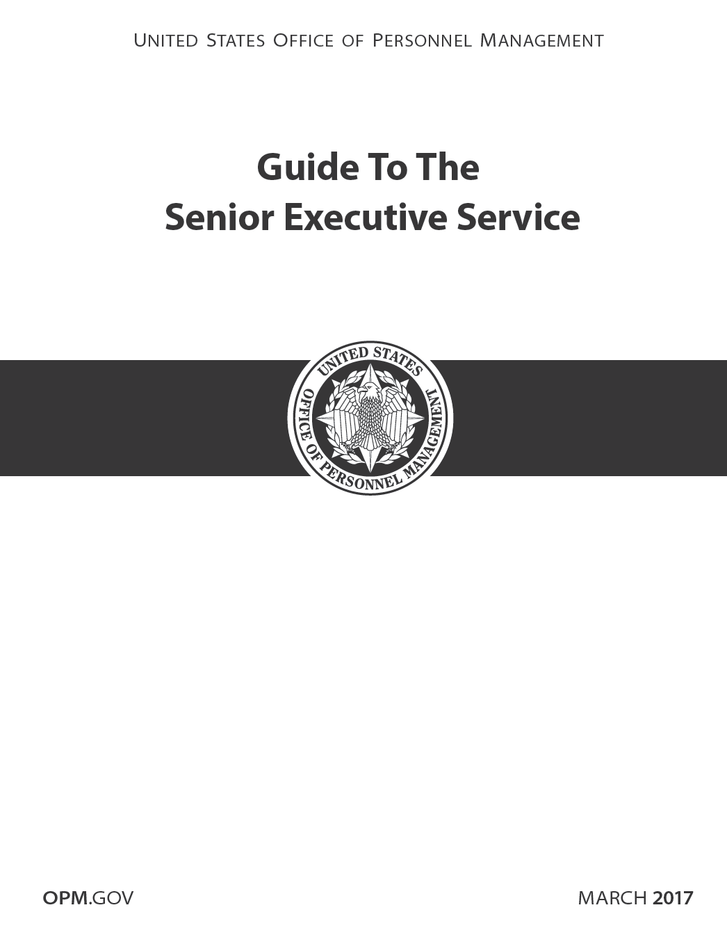
Resources

Slide 27
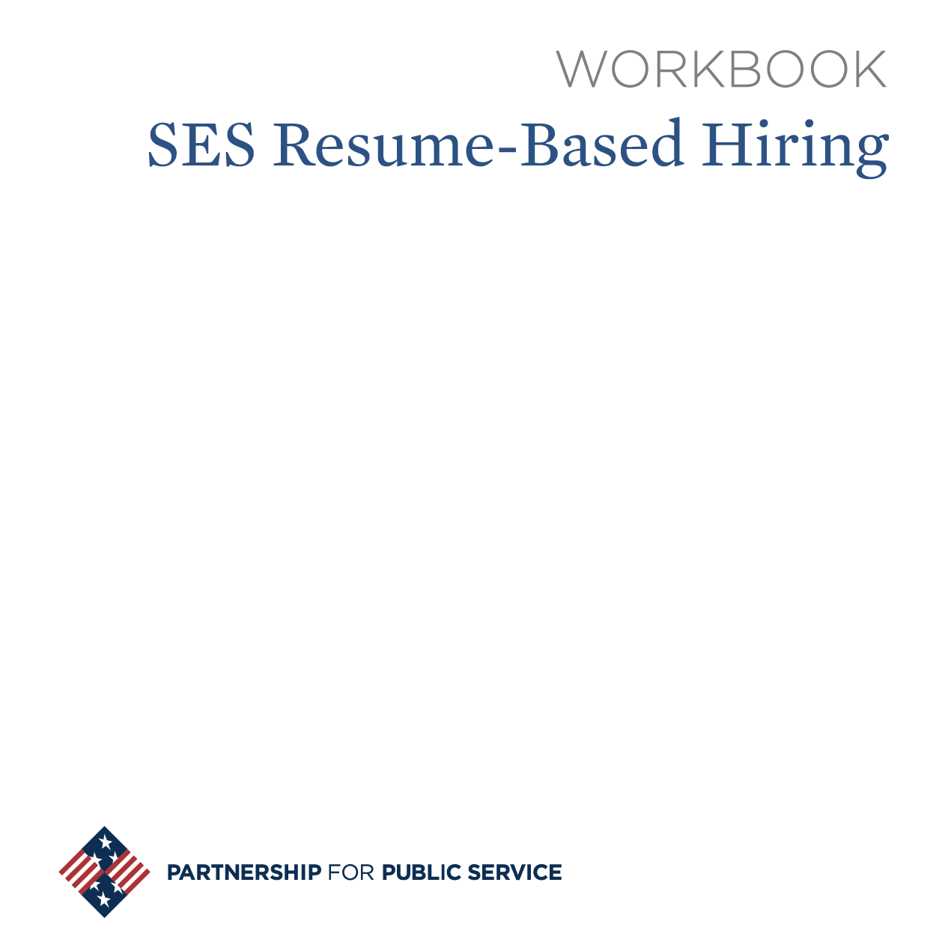
Resources, continued
Notes:
PPS – free dwnload: https://ourpublicservice.org/publications/viewcontentdetails.php?id=78
Other titles available on Amazon

Slide 28
Serving In An SES Position
Onboarding Roadmap | First 90 Days

Slide 29
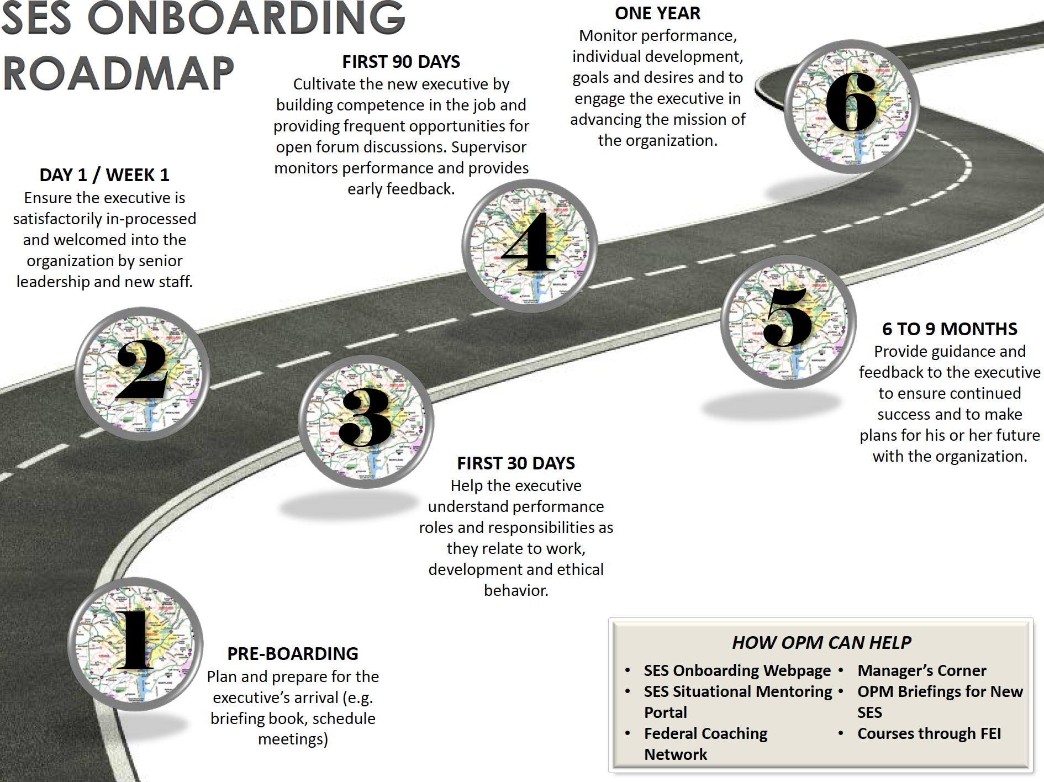

Slide 30
Your First 90 Days
Promote Yourself
A New Job Requires a New Approach
Accelerate Your Learning
Match Strategy to Situation
Secure Early Wins
Negotiate Success
Achieve Alignment
Build Your Team
Create Coalitions
Test Their Judgment
Notes:
Excellent way to assess your understanding of the position you are applying for and preparing you for your interview.
Book summary available at http://www.papensouth.org/PDF/The_First_90_Days.pdf.

Slide 32
Closing Thought
Public service is a remarkable privilege. Holding onto the ideal of being a part of something bigger – more – than any single person in pursuit of the collective greater good is perhaps our most important reason to serve.
Being intentional about how and where we serve holds great promise for enhancing our democracy – one public servant at a time, one leader at a time, one organization at a time.

